Slide 1

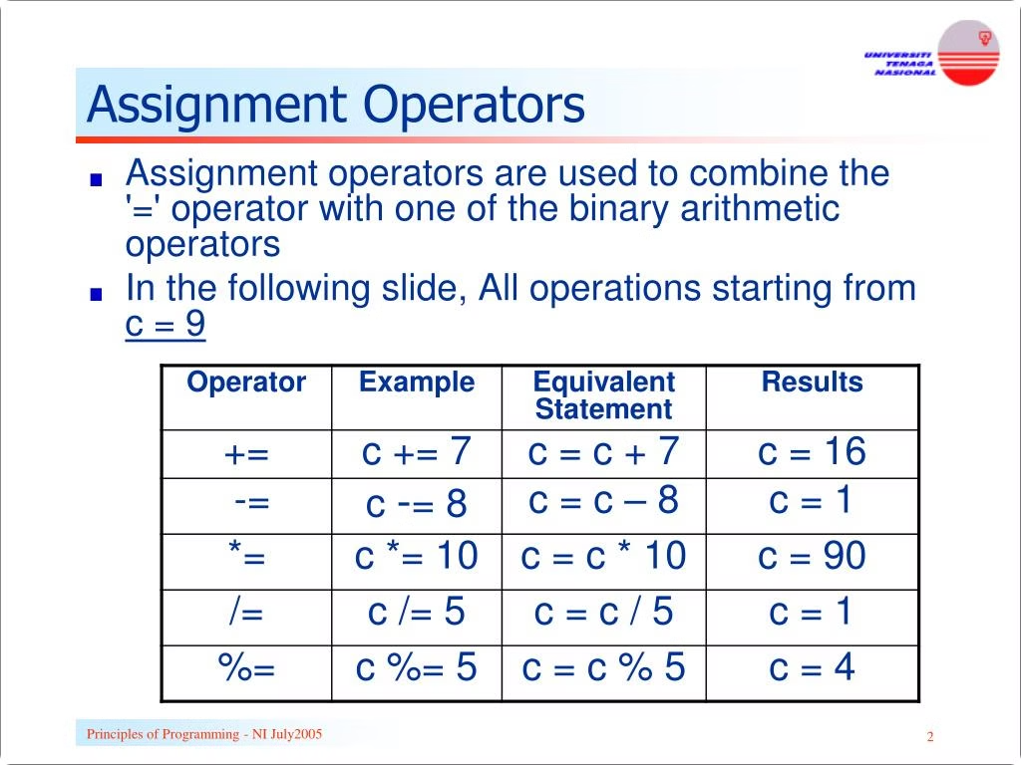

Operators in C
This chapter covers the various operators in C, including arithmetic, relational, logical, assignment, increment/decrement, and bitwise operators. Each operator is explained with examples and key concepts like precedence and associativity.
by Istiak Rahman

Slide 2
Arithmetic Operators
Addition (+)
Subtraction (-)
Multiplication (*)
Adds two operands.
Subtracts the second operand from the first.
Multiplies two operands.
Example: int sum = x + y;
Example: int product = x * y;
Example: int difference = x - y;

Slide 3


Relational Operators
Operator
Description
Example
==
Equal to
if (x == y)
!=
Not equal to
if (x != y)
>
Greater than
if (x > y)
<
Less than
if (x < y)
>=
Greater than or equal to
if (x >= y)
<=
Less than or equal to
if (x <= y)

Slide 4

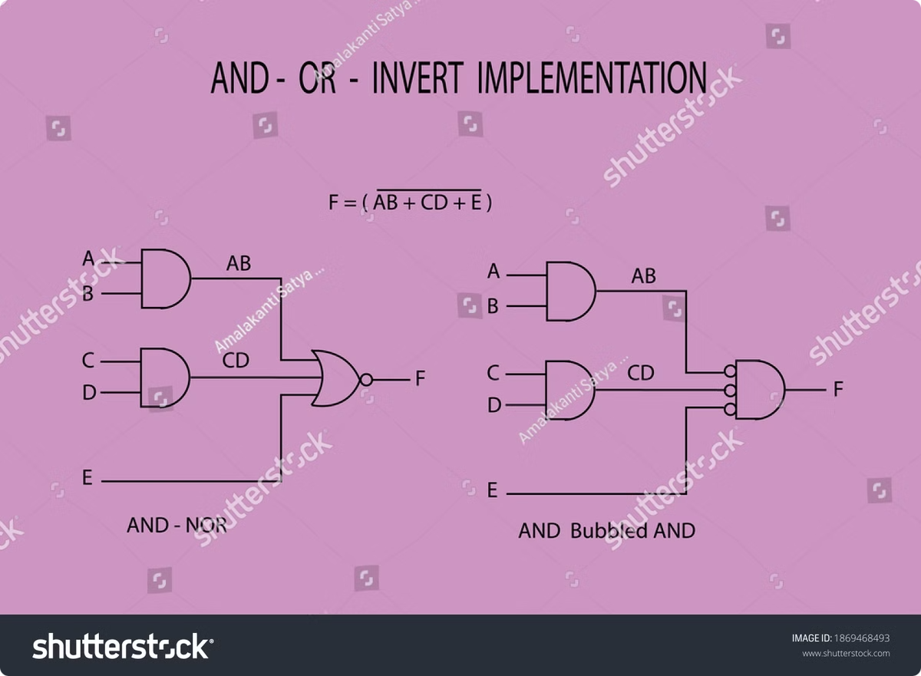
Logical Operators
1
Logical AND (&&)
Returns true if both operands are true.
2
Logical OR (||)
Returns true if at least one operand is true.
3
Logical NOT (!)
Inverts the truth value of an operand.

Slide 5





Assignment Operators
= (Assign)
Assigns a value to a variable.
+= (Add and Assign)
Adds the right operand to the left operand and assigns the result to the left operand.
-= (Subtract and Assign)
Subtracts the right operand from the left operand and assigns the result to the left operand.
*= (Multiply and Assign)
Multiplies the right operand with the left operand and assigns the result to the left operand.
/= (Divide and Assign)
Divides the left operand by the right operand and assigns the result to the left operand.

Slide 6


Increment and Decrement Operators
++ (Increment)
Increases the value of a variable by 1.
-- (Decrement)
Decreases the value of a variable by 1.

Slide 7

Thank You!
Presented by: Istiak Rahman
Email: istiak.rahman1020@gmail.com
Thank you for your attention! I appreciate your time and interest.
Keep Learning, Keep Growing

